Slide 1


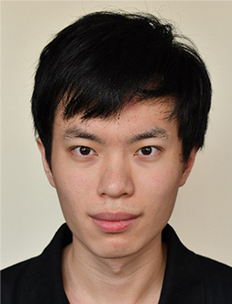

TOMOWORK GOAL SETTING WORKSHEET
NAME
Jacob Tan
INSTITUTE
Nanyang Polytechnic
GOAL START DATE
20 MARCH 2023
GOAL COMPLETION DATE
1 JUNE 2023
MY CAREER GOAL IN ___ YEARS
WORK
Part Time, Internship: (3D modelling, Animation, Environment)
LEARNING
Training Lifelong software: (Unity, Maya, Zbrush)
ACTIVITIES
Volunteer: (Concept art, Animation)
5 THINGS I WANT TO ACHIEVE FROM TAP (Please include more than 1 soft skills)
ACTION THAT WILL HELP ME TO REACH MY GOAL
REVIEW
(REVIEW BY 31 MAY MORNING)
1 | Understanding management
2 | Communication with others
3 | Overcome my fear
4 | Let go of my pain
5 | Paitence Management
1 | Improve on my skills
2 | Do more research for jobs
3 | Improve on my portfolio
4 | Make new friends
5 | Seek more knowledge
1
2
3
4
5
COMMENTS FROM FACILITATORS

